Slide 1

SourceTree for Mac & Windows

Slide 2
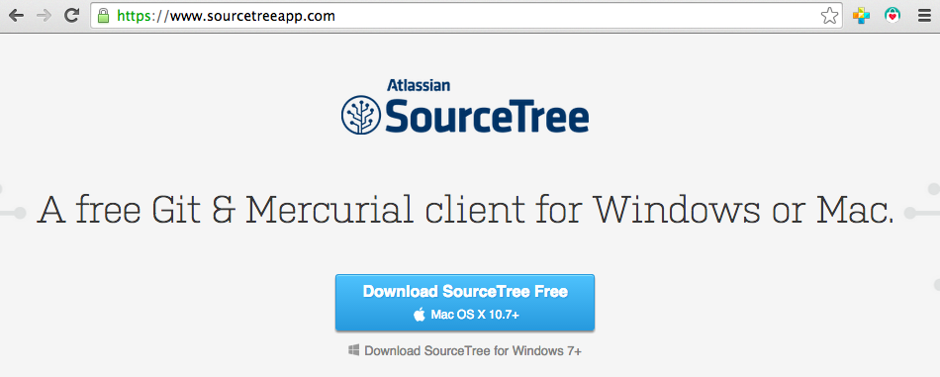
www.sourcetreeapp.com

Slide 3


Slide 4
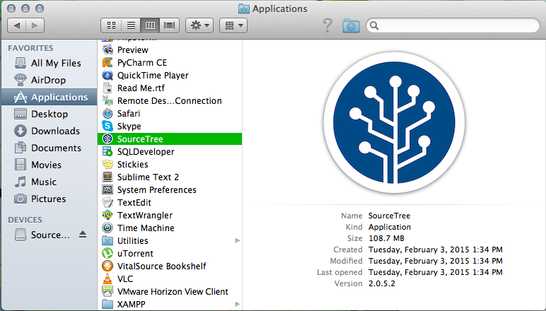
Open from Applications folder.

Slide 5
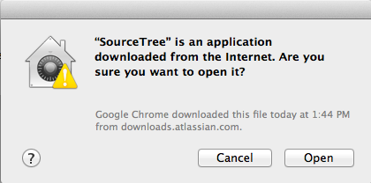
If prompted, click Open.

Slide 6
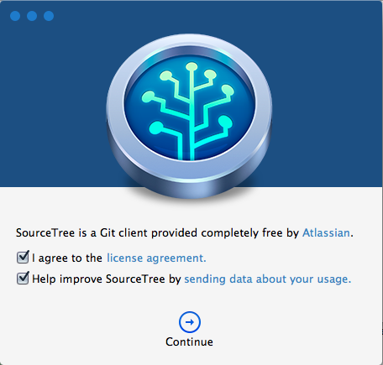

Slide 7
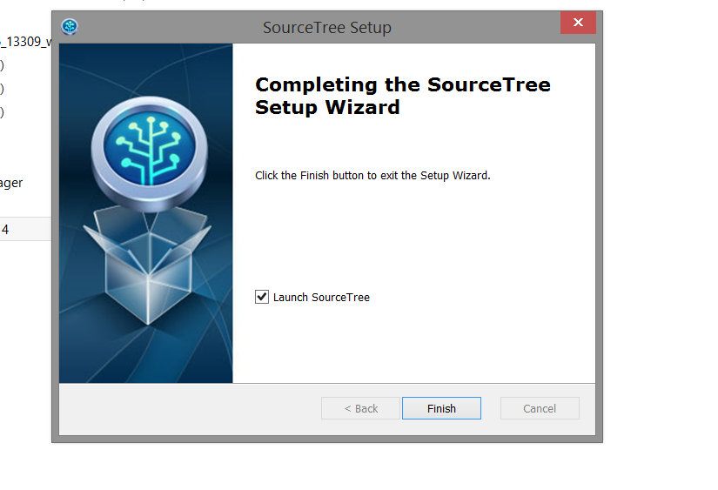
Windows Completion screen

Slide 8
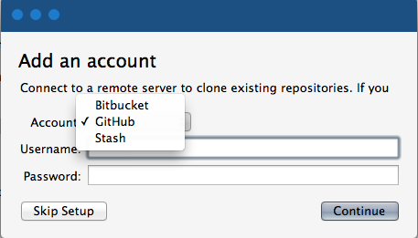
Select GitHub and enter credentials.

Slide 9
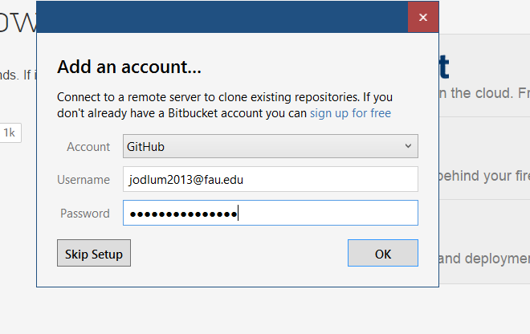
Do not add the @fau.edu

Slide 10
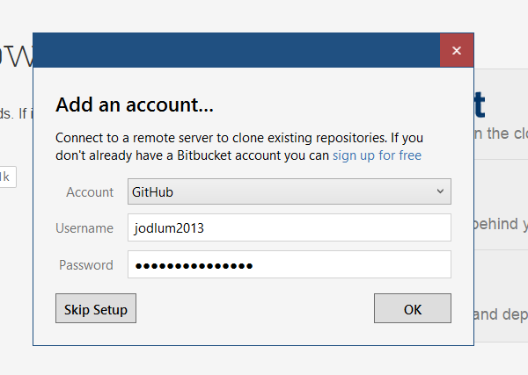
Without @fau.edu

Slide 11
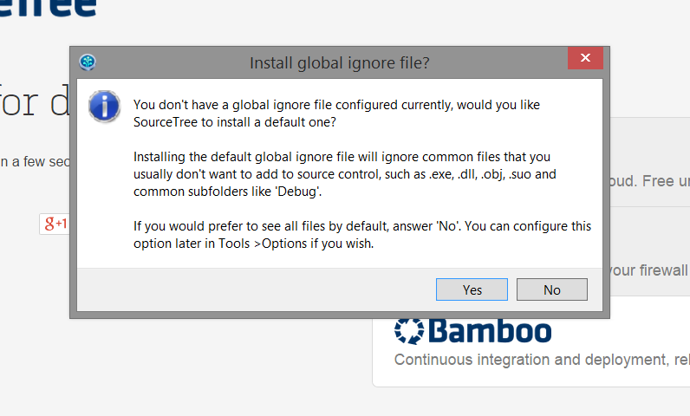
Windows Screen

Slide 12
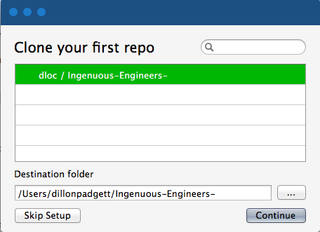
Select destination for repository.

Slide 13
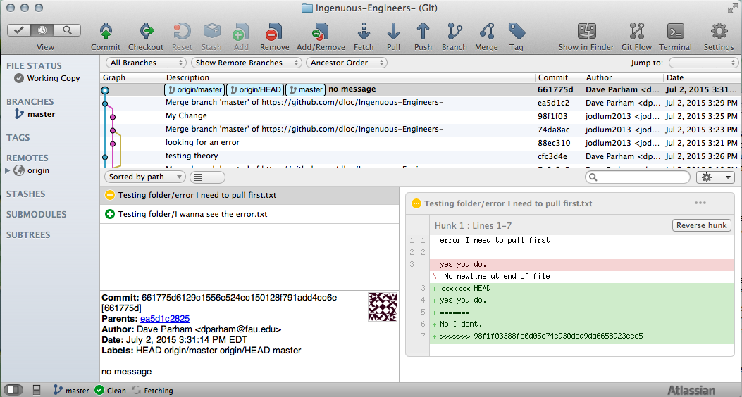
You’re there!

Slide 14
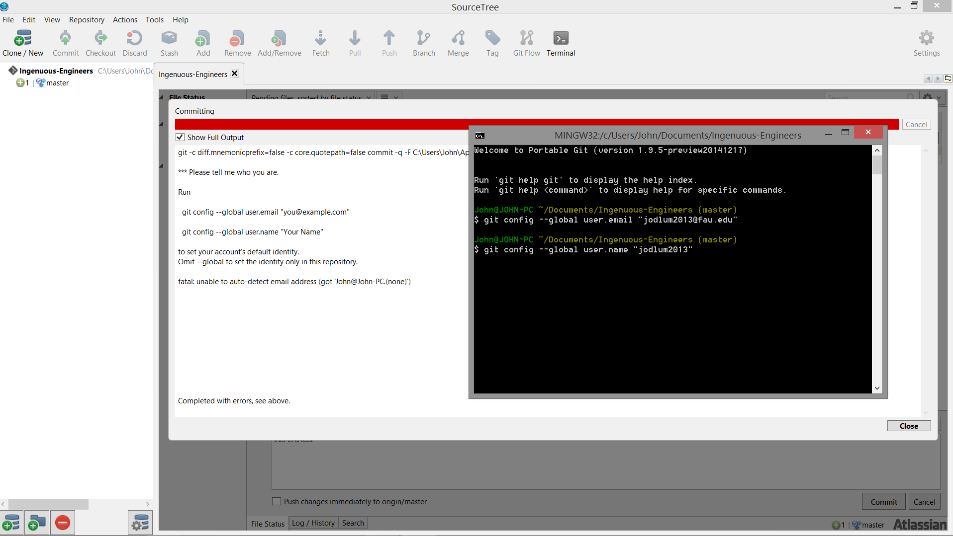
First Push Error Open Terminal

Slide 15
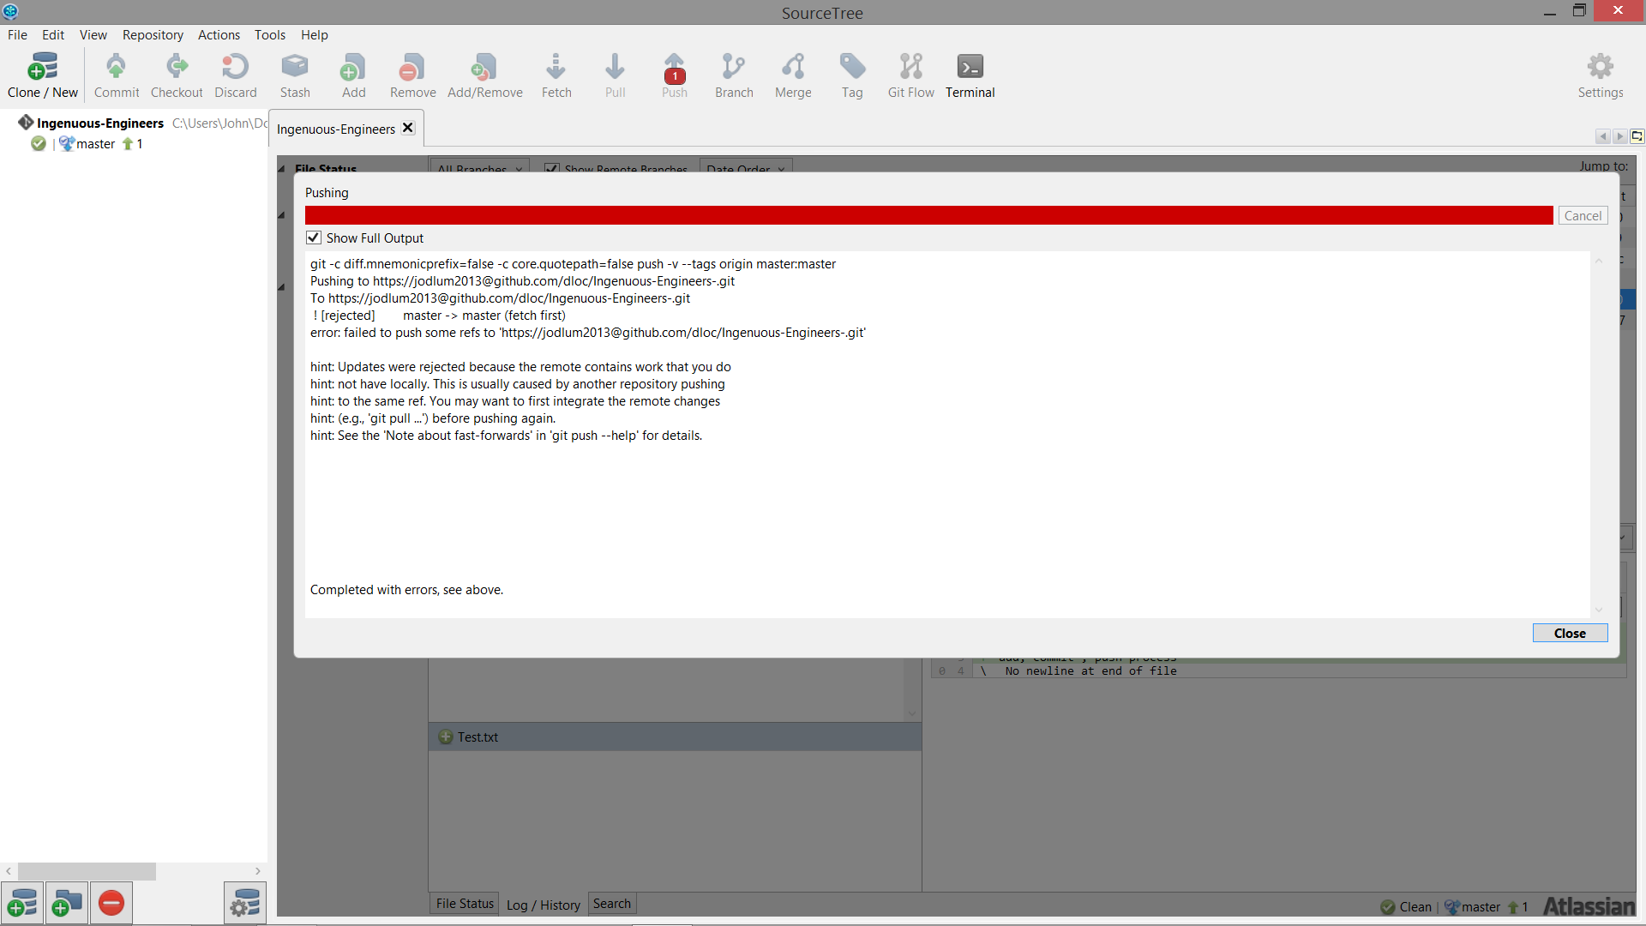
I need to PULL before I PUSH

